Slide 1


Network Security with LSTM-powered Irregularity Detection
Laasya Vajjala & Surya Pramod Vadapalli

Slide 2

Introduction
Overview
Introduction
Background
Objective
Methodology
Implementation
Results
Discussion
Conclusion
References
https://cointelegraph.com/
2

Slide 3

Introduction
Introduction
Network Security: Practice of protecting computer networks and the data they contain from unauthorized access, misuse, or disruption.
Threats: Malware, Phishing attacks, Data breaches, and Insider threats.
Real World Attacks:
The Great Data Breach (2013)
The Colonial Pipeline Ransomware Attack (2021)
https://cointelegraph.com/
3

Slide 4
Background
LSTM: Recurrent neural network (RNN) architecture, specifically designed to overcome the vanishing gradient problem and capture long-range dependencies in sequential data.
Particularly effective for analyzing time-series data due to their ability to retain information over long periods.
Irregularity Detection in Network Security:
Identifying Anomalies
Early Threat Detection
Protecting Data Integrity
Maintaining Operational Continuity
LSTM networks offer a powerful tool for analyzing time-series data and detecting irregularities in network traffic, addressing key challenges in network security such as dynamic threats, data volume, and imbalanced datasets.

Slide 5

Objective
LSTM-Powered Irregularity Detection System:
By applying LSTMs to network traffic analysis, we aim to create a system that can effectively identify irregular or anomalous patterns in network traffic that deviate from normal behavior.
Potential Threat Detection:
DDoS attacks
Malware infiltration
Benefits: To address the limitations of traditional intrusion detection systems (IDS) that rely on predefined signatures or statistical methods.
Analyze network traffic data as it occurs, allowing for immediate identification and response to potential security incidents.
Efficiently analyze large datasets and adapt to the ever-increasing volume and complexity of network traffic.

Slide 6

Methodology
Data Collection and Preprocessing: Dataset-Unicauca-Version2-87Atts.csv from Kaggle (IP Network Traffic Flows)
Total bytes, Bytes sent, Bytes received, Total packets, packets sent, packets received, Is anomaly
1M network traffic data
LSTM Model Architecture:
Defined using PyTorch's nn.Module class, specifying the input size, hidden size, number of layers, and the structure of the LSTM and fully connected layers.
Activation functions: Sigmoid to model the non-linearities within the network.

Slide 7
Methodology
Training procedure:
Adam optimizer with a specified learning rate, and a learning rate scheduler is employed to adjust the learning rate during training.
Gradient clipping is applied to prevent exploding gradients.
Evaluation metrics:
Loss function (Binary Cross Entropy), confusion matrix, ROC curve, AUC (Area Under the Curve), and classification report (precision, recall, F1-score)
Visualization:
ROC curve
Confusion matrix

Slide 8
Implementation
Programming Language and Libraries:
Python
Libraries: Pytorch, Matplotlib, Numpy, Pandas, Seaborn
Oversampling:
Anomaly class oversampling is employed to balance the class distribution and improve model performance on rare events.
Sequence Length Handling:
The input sequences are handled by adding a sequence length dimension and permuting the tensor dimensions appropriately to match the input requirements of the LSTM model.

Slide 9
Implementation
Gradient Clipping:
Gradient clipping is applied during training to prevent exploding gradients and stabilize the training process.
Learning Rate Scheduling: A learning rate scheduler is added to adjust the learning rate during training, which helps in optimizing the training process and achieving better convergence.

Slide 10
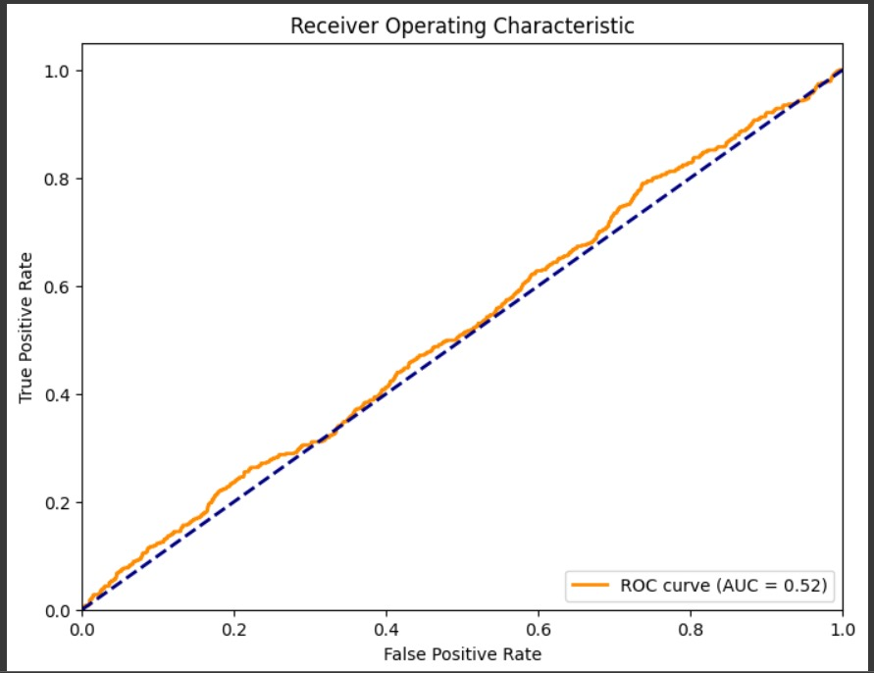
Results
Receiver Operating Characteristic (ROC) Curve:
ROC curves are used to evaluate the performance of binary classification models. A binary classification model is a model that attempts to predict the probability of an outcome belonging to one of two classes.
The area under the ROC curve (AUC) is a measure of how well the model performs overall.
AUC of 1 indicates perfect performance
Our model: AUC 0.52 (Much better than random guessing)

Slide 11
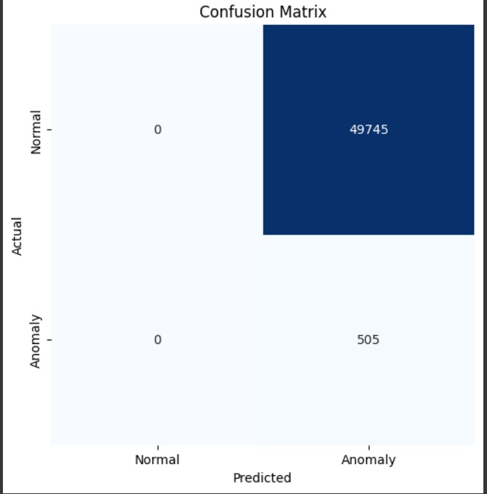
Results
Confusion Matrix:
A confusion matrix is a table that is used to evaluate the performance of an algorithm, often in the context of classification problems.
The rows represent the actual categories of the data, and the columns represent the detected categories of the data.
Analysis:
49,745 true negatives (These are normal data points that were correctly classified as normal.)
505 true positives (These are anomalous data points that were correctly classified as anomalous.)

Slide 12

Discussion
Strength:
AUC of 0.52, indicating that it has learned meaningful patterns in the data and can distinguish between normal and anomalous network traffic to some extent.
High True Negative Rate, effectively identify normal network behavior.
Limitations:
AUC Below Perfect, there is room for improvement in its performance.
Imbalanced Data, still exhibit uneven distributions between normal and anomalous samples, which can affect the model's ability to generalize.

Slide 13
Discussion
Challenges:
Dynamic Nature of Threats, developing a detection model that can adapt to new attack vectors and techniques.
Imbalanced datasets pose challenges for machine learning algorithms, leading to biased models and suboptimal performance.
Future Work:
Implementing a system for continuous monitoring and updating of the model can help address the dynamic nature of cyber threats.
Exploring advanced sampling techniques such as SMOTE (Synthetic Minority Over-sampling Technique) or ADASYN (Adaptive Synthetic Sampling) could further mitigate the effects of data imbalance.

Slide 14
Conclusion
Key Findings:
Our project developed an LSTM-powered irregularity detection system for network security, achieving an AUC of 0.52 and correctly classifying 49,745 true negatives and 505 true positives.
Significance:
LSTM-powered irregularity detection plays a crucial role in identifying and mitigating security threats within network traffic data, enhancing the resilience and effectiveness of network defense mechanisms.
Broader Implications:
The application of LSTM networks in network security extends beyond anomaly detection, with potential applications in intrusion detection, malware analysis, and threat intelligence. This work contributes to the advancement of cybersecurity technologies and the protection of digital assets in an increasingly interconnected world.

Slide 15
References
Chalapathy, R., Chawla, S., & Robinson, P. (2019). Deep Learning for Anomaly Detection: A Survey. arXiv preprint arXiv:1901.03407.
Kandanaarachchi, S. & Hyndman, R. J. (2021), ‘Dimension Reduction for Outlier Detection Using DOBIN’, Journal of Computational and Graphical Statistics
URL: https://doi.org/10.1080/10618600.2020.1807353
Ma, X., Wu, J., Xue, S., Yang, J., Zhou, C., Sheng, Q. Z., Xiong, H. & Akoglu, L. (2021), ‘A comprehensive survey on graph anomaly detection with deep learning’, IEEE Transactions on Knowledge and Data Engineering.

Slide 16
Thank You Any Questions?

